Slide 1
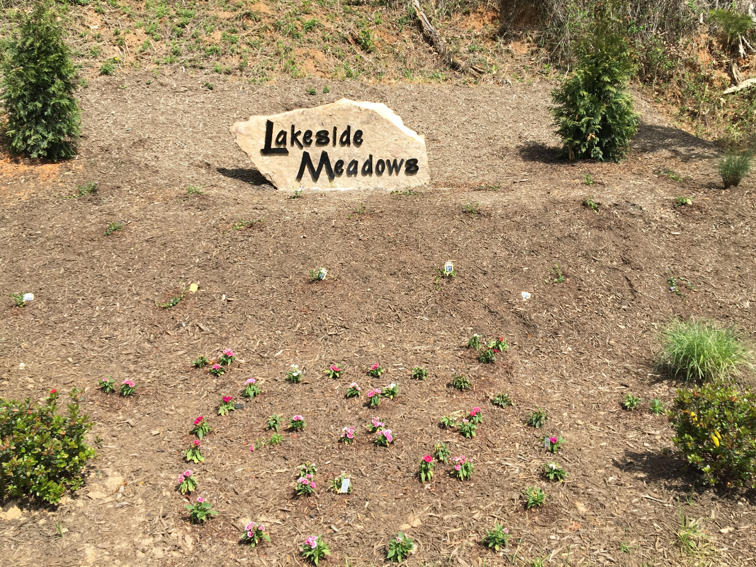
Lakeside Meadows
Homeowners’ Association, Inc.
Welcome to the
2017 Annual Meeting
April 22, 2017
3:00 – 5:00 pm
Weaverville Library

Slide 2
Additions to the Agenda?

Slide 3
Your Board of Directors
Ruth O’Donnell, Director and President
Scott Hughes, Director and Treasurer
Julia Book, Director and Secretary
Kathyrn DiMaio, Director
Christina Morrissey, Director

Slide 4
Architectural Review Committee
ARC
Katherine DiMaio, Chairperson
Christina Morrisey
Doreen Shaughnessy

Slide 5


Other Committees
Sign-up sheets going around
Social, Christine Wells, Chairperson
  Planning neighborhood social events
Common Areas
  Maintenance contract
  Improvements
Communications
  Website

Slide 6
Minutes of April 10, 2017 Board Meeting
Board Vote
&
Treasurer’s Report
Scott Hughes

Slide 7

Progress Report
Terms of office established
  One year: Julia, Ruth
  Two years: Christina, Katherine, Scott
Officers appointed
Board meeting schedule set
  July 24, 7:00 pm
  October 23, 7:00 pm
  January – 2018 Board

Slide 8

Address and registered agent changed with NC Division of Corporations
Federal EIN received
Official seal of the Corporation purchased
Duke Power account set up
Insurance purchased

Slide 9


Bids for common area maintenance
Email address: lakesidemeadowshoa2@gmail.com
Website purchased and started - lakesidemeadowshoa.org
Architectural Review Committee and other committees established
Policies in process

Slide 10
Documents that Guide the HOA
NC Statute 47F: North Carolina Planned Community Act
Declaration of Covenants, Conditions and Restrictions for Lakeside Meadows
Lakeside Meadows ARC Standards – not yet developed
  Why do we need them?
  Questionnaire

Slide 11
ARC Review Process
Please hold questions until after the presentation
ARC Policies & Procedures (sent to you)
  Policies – What the ARC does
  Procedures – How they do it

Slide 12
Submit
Form
ARC Review
Resubmit if Needed
    Step 1: Application (sent to you with a sample)
    Step 2: Review by Committee and decision sent within 30 days
    Step 3: Resubmission if needed

Slide 13
Amendment to Covenants & Restrictions
Multiple homeowners asking for the change
Requires a vote of homeowners with 67% (17) of the 25 approving
Not in effect until recorded with Buncombe Register of Deeds
Board moves approval of the amendment
Discussion
Vote of homeowners

Slide 14

Questions and Comments from Homeowners on other HOA related topics?

